Slide 1
Reinforcement-Learning-based navigation for autonomous vehicles
Author : Abdalla Mohamed
Supervisor : Prof. Dr. Ayman A. El-Badawy
Reviewer : Dr. Tamer Ismail

Slide 2
Outline
Introduction
Literature review
Aim of the thesis
Implementation
- Environment
- RL algorithms
- Kinematic model
Results
Conclusion
Future Work
References

Slide 3
Introduction
Autonomous Navigation

Slide 4
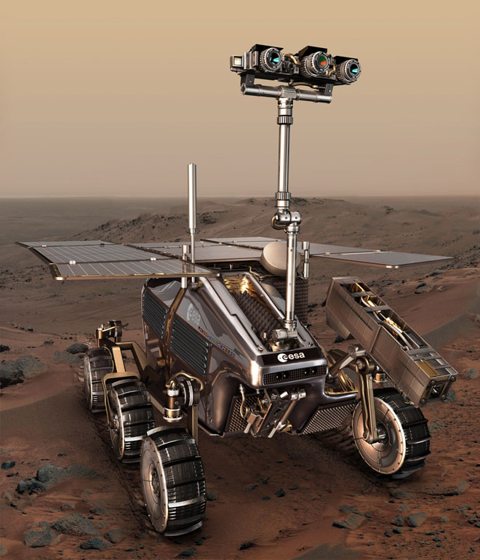
Importance of autonomous vehicles
Unmanned driving
Rescue operations
Exploring harsh environments
Navigating remote places
[6]

Slide 5
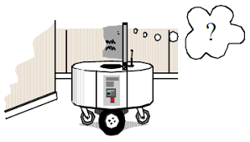
Autonomous Navigation
The robot must ask Three key questions
Where am I ?
Where am I going ?
How do I get there ?
[5]

Slide 6
Navigation
Localization
Mapping and Path-planning
Trajectory following
Getting the exact pose of the robot in respect to the environment
Motion control
Following the planned path
Building a map
Planning an optimal path
Avoiding obstacles

Slide 7
Introduction
Reinforcement Learning

Slide 8

What is Reinforcement Learning ?
Artificial Intelligence
Techniques that enable machines to mimic human behavior
Machine Learning
Subset of AI technique including supervised, unsupervised and reinforcement learning
Deep Learning
Subset of ML that make use of multi-layer deep neural networks
[7]

Slide 9
Machine Learning
Supervised Learning
Learns using labeled Data
Solves Classification and regression problems
Unsupervised Learning
Learns using unlabeled data
Solves association and clustering problems
Reinforcement Learning
Derived from psychology and animal behavior
Learns by interacting with the environment
Depends on trial and error

Slide 10
Why Reinforcement Learning
Does not require a data set
Adaptive and flexible
Widely used in navigation tasks

Slide 11
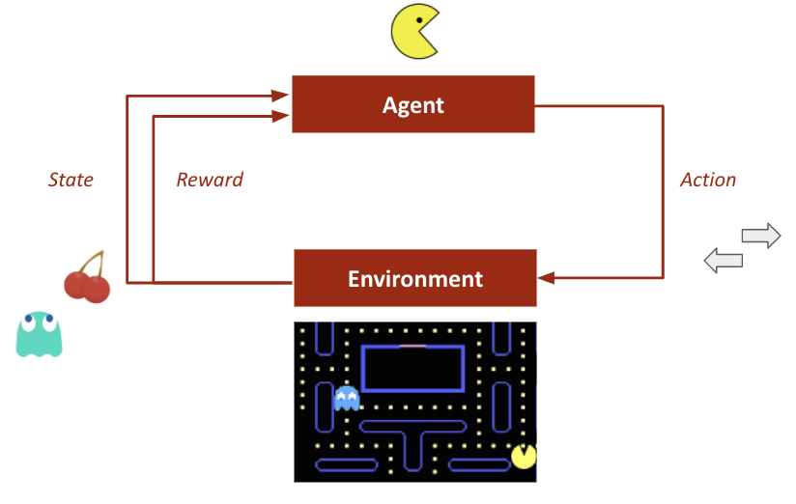
Markov decision process
Agent : the mind that take actions ( Pacman)
State : The current situation of the agent
Actions : all possible moves
Reward : A signal stating how good or bad our action was in a given state ( Pac-mac score)
Policy : The strategy that the agent employs to determine next actions (Pac-Man tactics)
Environment : The agent surroundings
[8]

Slide 12

Your brain is the Agent
The world is your Environment
Dopamine is your Reward Function
Your Policy is the way you act to the world situations
Your goal is to maximize the reward function

Slide 13
Literature review

Slide 14
In 2011 , handy wikasono used Q-learning to develop an obstacle avoidance behavior on a mobile robot . [1]
In 2015, Emanuele Vitolo studied the effect of manipulating Dyna-Q algorithm parameters to achieve better results .
[2]
In 2017, Vikas Kumar proposed an obstacle avoidance technique for wheeled mobile robot based on Deep-Q-Learning.
[3]
In 2019, Yotaro Yamaguchi concluded that adding a target network to the deep Q-learning algorithm maximized the score of the agent at Atari games.
[4]

Slide 15
Thesis Aim

Slide 16
Implement and simulate navigation tasks of a four wheeled robot using an efficient RL algorithm as a path planner

Slide 17
Implementation
Environment

Slide 18
Environment features
Python-based environment from OpenAi Gym Discrete grid-world 25 by 25
The green state is the agent starting position
The red cell is the target (terminal state)
cells colored in black are the obstacles
The agent has four discrete actions :
0 : up
1 : down
2 : left
3 : right
[9]

Slide 19
Environment features
There are 625 different states
The state is the 2d array representation of the environment
Free cells represented by zeros
Obstacles represented by ones
Agent position is represented by 2
Target position is represented by 3
2
3

Slide 20
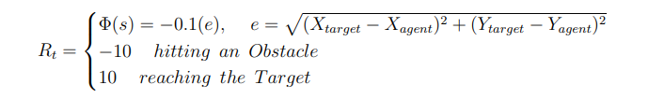
Reward Shaping
Evaluate the agent actions
The agent goal is to maximize the cumulative reward
Resembles the objective function in control theory
The reward function is divided into 3 cases
We used potential-based reward approach that penalize the agent based on its distance from the target

Slide 21
Implementation
RL algorithms
Q-Learning
Dyna Q-Learning
Deep-Q- Learning

Slide 22
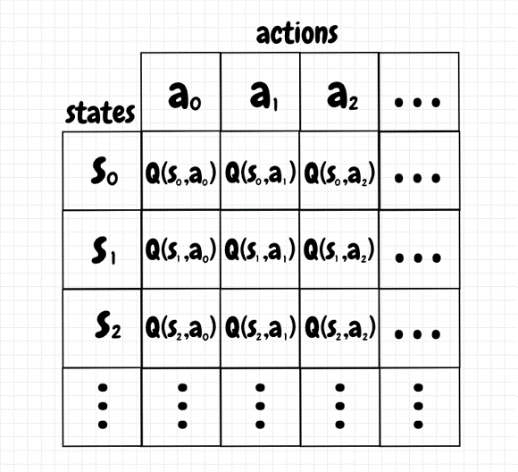
Q-Learning
Q-learning is a model-free RL algorithm
It estimates the action-value function Q(s,a)
Each state-action pair has a Q-value
The Q-value is calculated using bellman update equation
Gain experience from real interactions by either exploring or exploiting
[10]
New Q-value
Old Q-value
Learning rate
/ step-size
Reward
Discount rate
Maximum Q-value of the next state – old Q-value

Slide 23
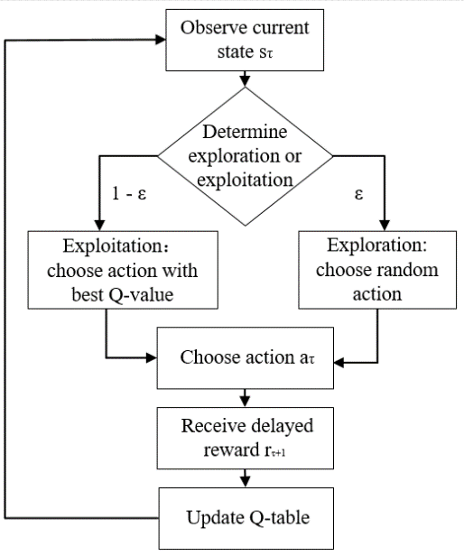
Q-learning
Uses Epsilon-greedy policy
Epsilon (ε) determines how often the agent acts randomly
Updates the Q-values after every transition
The Q-table is updated till the Q-values converge to their final value or till the agent reaches a terminal state
[12]

Slide 24
Implementation
RL algorithms
Dyna-Q Learning

Slide 25
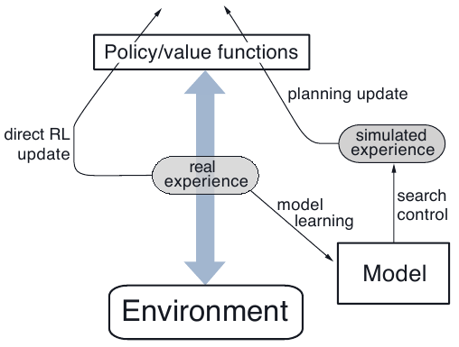
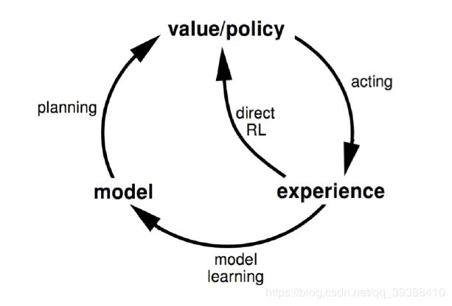
Dyna Q-learning
Model-based algorithm
The agent learns from both real and simulated experiences
Resembles playing chess
[12]
[12]

Slide 26
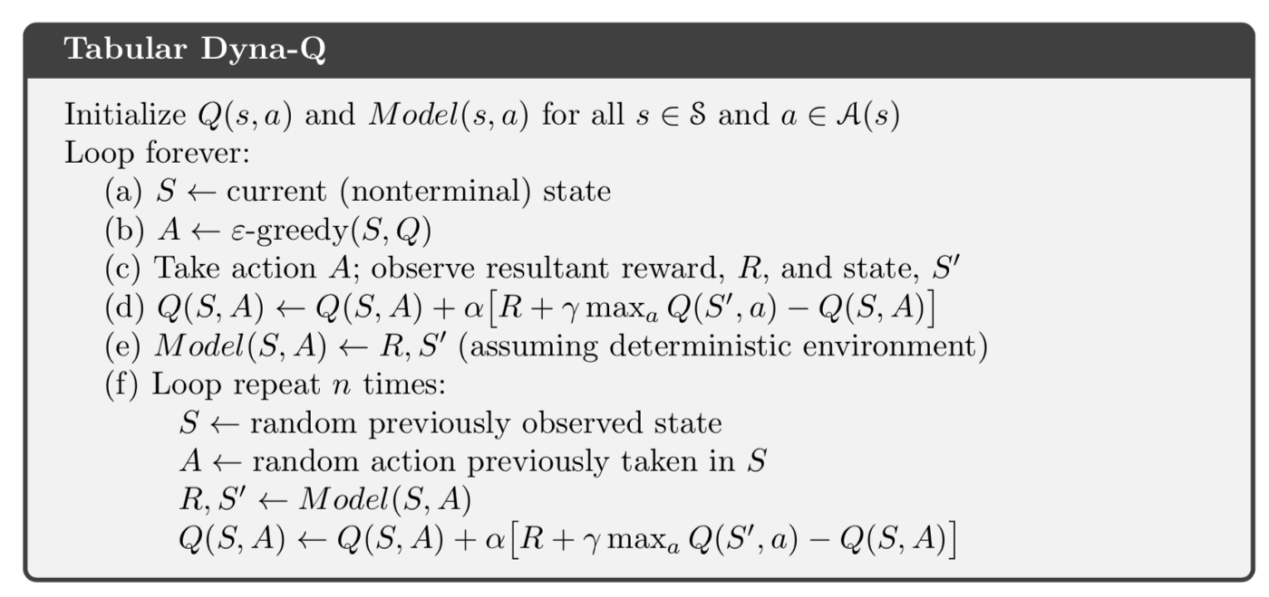
Dyna Q-Learning
Tabular Q-learning
Model Learning
Planning with random one-step Q-learning
Steps (a), (b), (c) and (d) are basic tabular Q-learning
Model learning is done in (e)
Planning is done in (f)
n is the number of planning steps
[12]

Slide 27
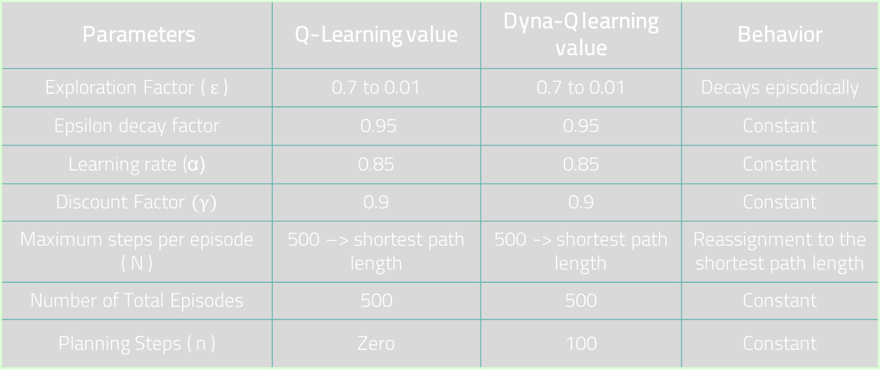
Parameters Tuning
Parameters | Q-Learning value | Dyna-Q learning value | Behavior
Exploration Factor ( ε ) | 0.7 to 0.01 | 0.7 to 0.01 | Decays episodically
Epsilon decay factor | 0.95 | 0.95 | Constant
Learning rate (α) | 0.85 | 0.85 | Constant
Discount Factor $(γ)$ | 0.9 | 0.9 | Constant
Maximum steps per episode ( N ) | 500 –> shortest path length | 500 -> shortest path length | Reassignment to the shortest path length
Number of Total Episodes | 500 | 500 | Constant
Planning Steps ( n ) | Zero | 100 | Constant

Slide 28
Implementation
RL algorithms
Deep Q-Learning

Slide 29
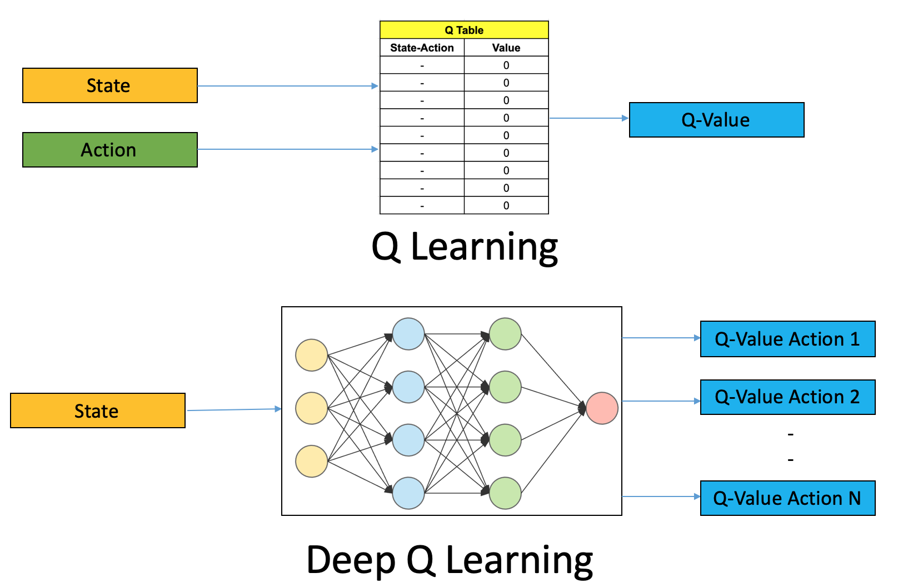
Deep Q-Learning
Replaces the regular Q-table with a neural network
Neural networks are function approximators
Input states are fed to the neural network and it spits out the action Q-values
Deals with continuous state-spaces and discrete action-spaces
[6]

Slide 30


Slide 31
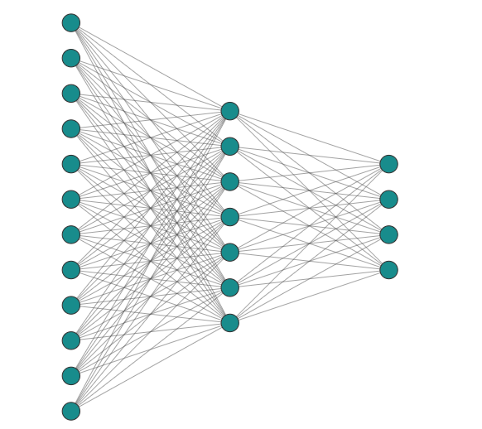
Deep-Q networks architecture
Our artificial neural network has 3 layers
Network layers are created using Keras library
Input layer : 625 nodes ( size of the state array )
Middle layer : 32 nodes
Output layer : 4 nodes ( size of the action space )
Relu activation function for the first 2 layers
Linear activation function for the output layer
Adam optimizer is used
Loss function was chosen to be Mean squared error ( MSE)

Slide 32
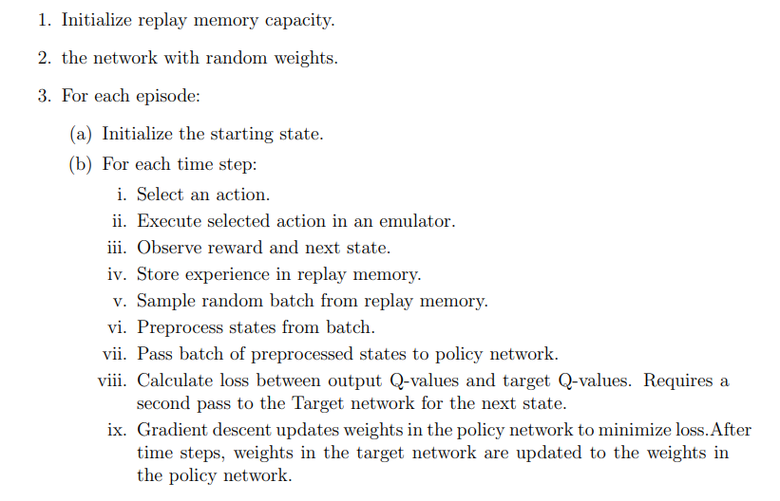
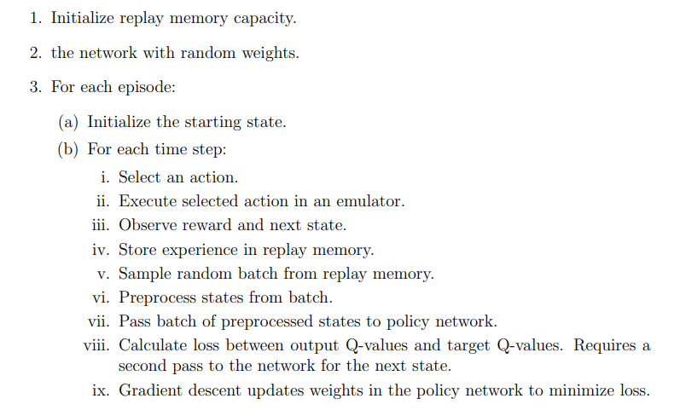
DQN training
Replay memory is a tuple of a fixed size that store state transition
State transition include ( State, action, reward, next_state, terminal)
The network spits out predicted Q-values
Target Q-values are obtained from the bellman equation
Require creation of a second copy of the main network to stabilize the algorithm
[12]

Slide 33
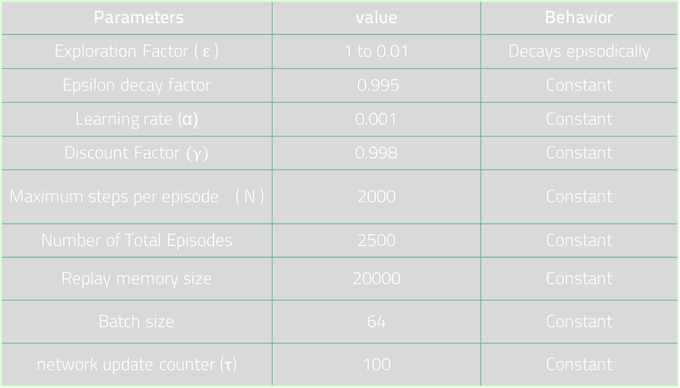
DQN Parameters
Parameters | value | Behavior
Exploration Factor ( ε ) | 1 to 0.01 | Decays episodically
Epsilon decay factor | 0.995 | Constant
Learning rate (α) | 0.001 | Constant
Discount Factor $(γ)$ | 0.998 | Constant
Maximum steps per episode ( N ) | 2000 | Constant
Number of Total Episodes | 2500 | Constant
Replay memory size | 20000 | Constant
Batch size | 64 | Constant
network update counter (τ) | 100 | Constant

Slide 34
Implementation
Kinematic model

Slide 35
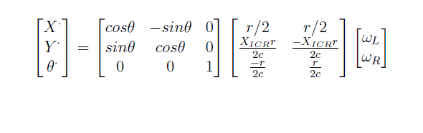
Kinematic model
Equations modelling the robot kinematic are included in the agent class
The right wheels are connected to the same motor and the same is done for the left wheels
The pose ( x, y, θ) of the robot can be determined by integrating the generalized velocity vector
7
7

Slide 36

Agent properties
The robot is the agent
(x, y, θ) is the state
The robot can take 4 actions
The robot has 2 motor velocities, : $ωr$ for the right wheels and : $ωl for the left wheels$
Moving Forward : $ωr=ωl ,ωr>0$
Moving Backward : $ωr=ωl ,ωr<0$
Moving left : $ωr=−ωl ,ωr>0$
Moving Right : $ωr=−ωl ,ωr<0$

Slide 37

The robot environment
The robot model moves in a continuous space
It is bounded to a virtual environment having a size of 4 m by 4 m to resemble the lab dimensions
After each transition the robot coordinates are mapped to the corresponding cell in the grid-world

Slide 38
Results
Comparison of Algorithms

Slide 39
Comparison measures
steps per episode ( The trajectory length)
Cumulative reward
Convergence speed
Success Rate

Slide 40
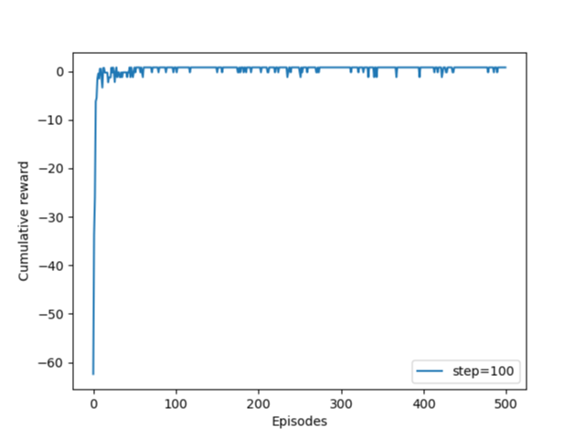
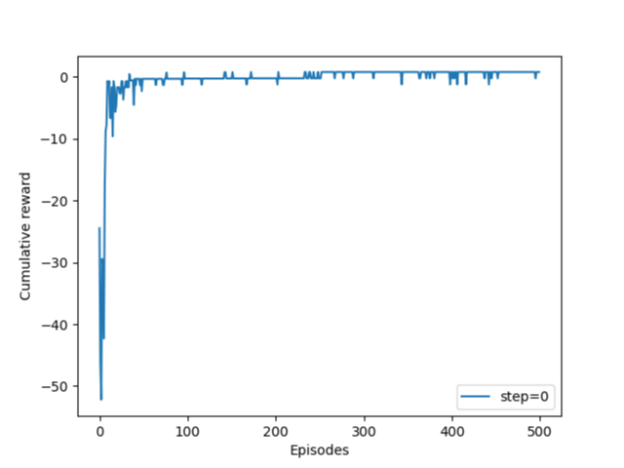
Cumulative reward
Dyna-Q agent
Q-learning agent
DQN agent

Slide 41
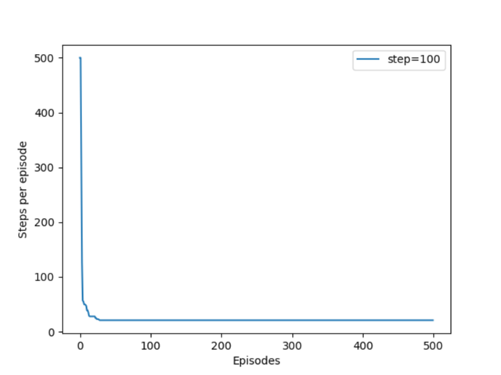
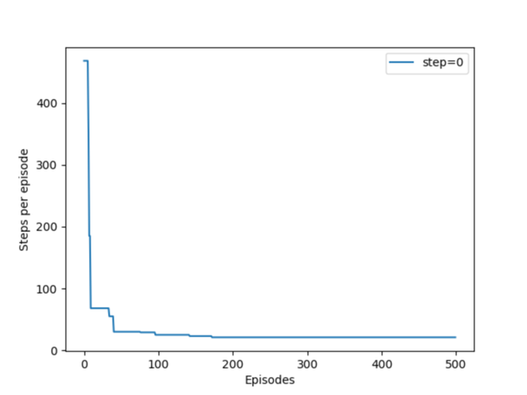
Actions per episode
Dyna-Q agent
Q-learning agent
DQN agent

Slide 42
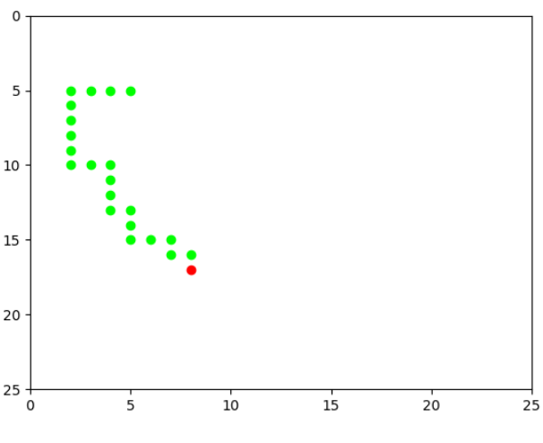
Statistics
Measure | Dyna-Q Learning | Q-Learning | DQN
optimal number of actions | 21 | 21 | 21
Maximum cumulative reward | 0.79 | 0.79 | 0.79
Success Rate | 92% | 88% | 80%
Convergence Speed | 35 episodes | 172 episodes | 600 episodes
Training Time | 25 minutes | 15 minutes | 300 minutes

Slide 43
Results summary
The 3 algorithms showed convergence
The 3 algorithms obtained high success rates
Dyna-Q has algorithm had the best success rate and the fastest convergence
Dyna-Q required less real interaction with environment which makes it the most cost efficient algorithm
DQN results showed random spikes due to the following reasons :
Model overfitting
The random nature of the policy
Agent gets trapped in infinite loops when visiting unfamiliar states

Slide 44
Results
Robot Simulation

Slide 45
Results on the robot model

Slide 46
Steps per episode
Optimal trajectory
Cumulative Reward
Measure | Dyna-Q-Robot
optimal number of actions | 16
Maximum cumulative reward | 0.79
Success Rate | 92%
Convergence Speed | 440

Slide 47
Random Starting point

Slide 48
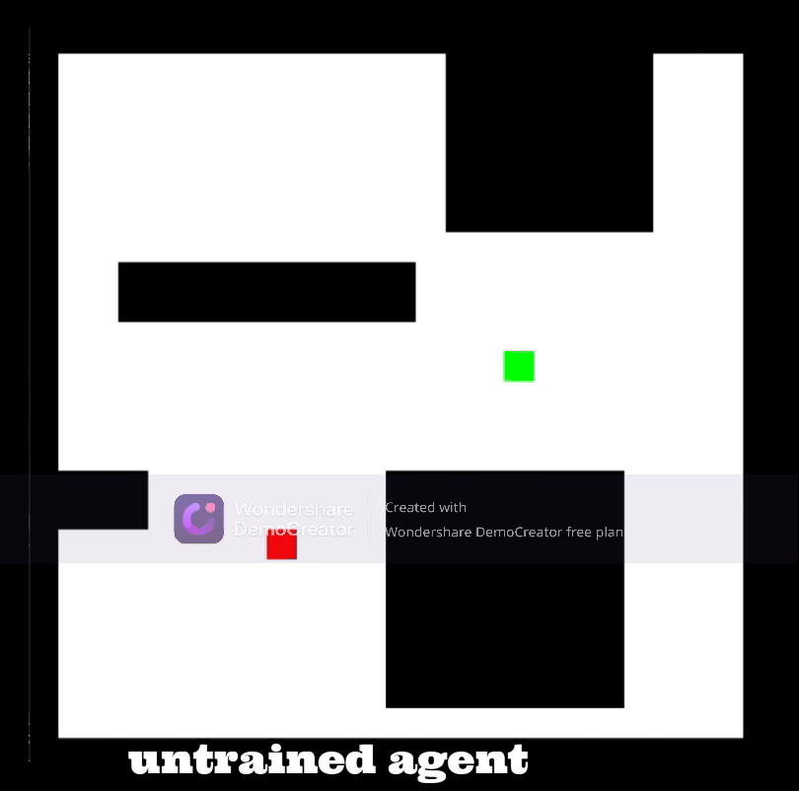

Slide 49
Map Invariance
Measure | Dyna-Robot
optimal number of actions | 24
Maximum cumulative reward | 0.77
Success Rate | 95%
Convergence Speed | 552

Slide 50
Conclusion

Slide 51
Conclusion
Q-learning, Dyna-Q learning and deep Q learning were implemented successfully and compared
The supremacy of Dyna-Q was shown in the results section
Successfully implemented a kinematic model of the robot that used the selected algorithm (Dyna-Q) to navigate successfully in discrete environments
The robot can navigate from random starting positions in unknown environments in the least number of real interactions with the environment
The robot always found the shortest trajectory
The agent succeeded in avoiding all the obstacles

Slide 52
Future recommendations

Slide 53
Possible future work
Hardware implementation
Fabricate a four wheeled mobile robot
Use camera vision to localize the robot
Provide the robot with a Raspberry Pi chip for online learning
Deploy the robot in an obstacle maze and record the results
Model enhancement
Extend the agent with a dynamic model for more realistic results
Take friction and skidding effects into consideration

Slide 54
References
[1] Viet, Hoang-huu & Choi, Seung-yoon & Chung, Tae-choong. (2013). Dyna-QUF: Dyna-Q based univector field navigation for autonomous mobile robots in unknown environments. Journal of Central South University. 20. 10.1007/s11771-013-1601-0.
[2] E. Vitolo, A. S. Miguel, J. Civera and C. Mahulea, "Performance Evaluation of the Dyna-Q algorithm for Robot Navigation," 2018 IEEE 14th International Conference on Automation Science and Engineering (CASE), 2018, pp. 322-327, doi: 10.1109/COASE.2018.8560457.
[3] P. K. Mohanty, A. K. Sah, V. Kumar and S. Kundu, "Application of Deep Q-Learning for Wheel Mobile Robot Navigation," 2017 3rd International Conference on Computational Intelligence and Networks (CINE), 2017, pp. 88-93, doi: 10.1109/CINE.2017.11
[4] Ohnishi, Shota & Uchibe, Eiji & Yamaguchi, Yotaro & Nakanishi, Kosuke & Yasui, Yuji & Ishii, Shin. (2019). Constrained Deep Q-Learning Gradually Approaching Ordinary Q-Learning. Frontiers in Neurorobotics. 13. 103. 10.3389/fnbot.2019.00103.
[5] Deep Q-Learning - Combining Neural Networks and Reinforcement Learning – deeplizard
[6] Sudharsan Ravichandiran. Hands-on Reinforcement Learning with Python: Master Reinforcement and Deep Reinforcement Learning Using OpenAI Gym and TensorFlow. Packt Publishing Ltd, 2018
[7] Alhawary. Reinforcement-learning-based navigation for autonomous mobile robots in unknown environments. Master’s thesis, University of Twente, 2018.
[8] Lazhar Khriji, Farid Touati, Kamel Benhmed, and Amur Al-Yahmedi. Mobile robot navigation based on q-learning technique. International Journal of Advanced Robotic Systems, 8(1):4, 2011.
[9] A. Turiot. An openai gymimplementation for the pathfinding problem. 2019.
[10] Hee Rak Beom and Hyung Suck Cho. A sensor-based navigation for a mobile robot using fuzzy logic and reinforcement learning. IEEE transactions on Systems, Man, and Cybernetics, 25(3):464–477, 1995.
[11] Reinforcement Learning algorithms — an intuitive overview | by SmartLab AI | Medium
[12] Richard S Sutton and Andrew G Barto. Reinforcement learning: An introduction. MIT press, 2018.

Slide 55
Thanks
Any Questions ?

Slide 56

Stabilizing the main network
Bellman equation :
Calculating the target values require 2 passes to the network $S_{t} and S_{t+1}$in order to calculate ${Q(S}_{t}, A_{t})and {Q(S}_{t+1},a)$
However values of ${Q(S}_{t+1},a)$ are constantly changing
The network will start chasing its tail due to chasing a moving target value
Target network is introduced to stabilize the network
The Target network is an exact copy of the main network
Its weights are freezed and updated every (τ) passes to create a stable target for the network

